Slide 1
MAP2GO
Team 22: Japtegh, Austin, En-Mien
Notes:
‹#›
‹#›

Slide 2
Agenda
Case of a truck driver
How we approach our work?
How Map2Go enhances usability?
Tutorials, Menu, Night mode, Search
How responsive is Map2Go?
M3 Path Finding, M4 Traveling Courier,
Pitch: Wildfire Management
Notes:
‹#›
‹#›

Slide 3

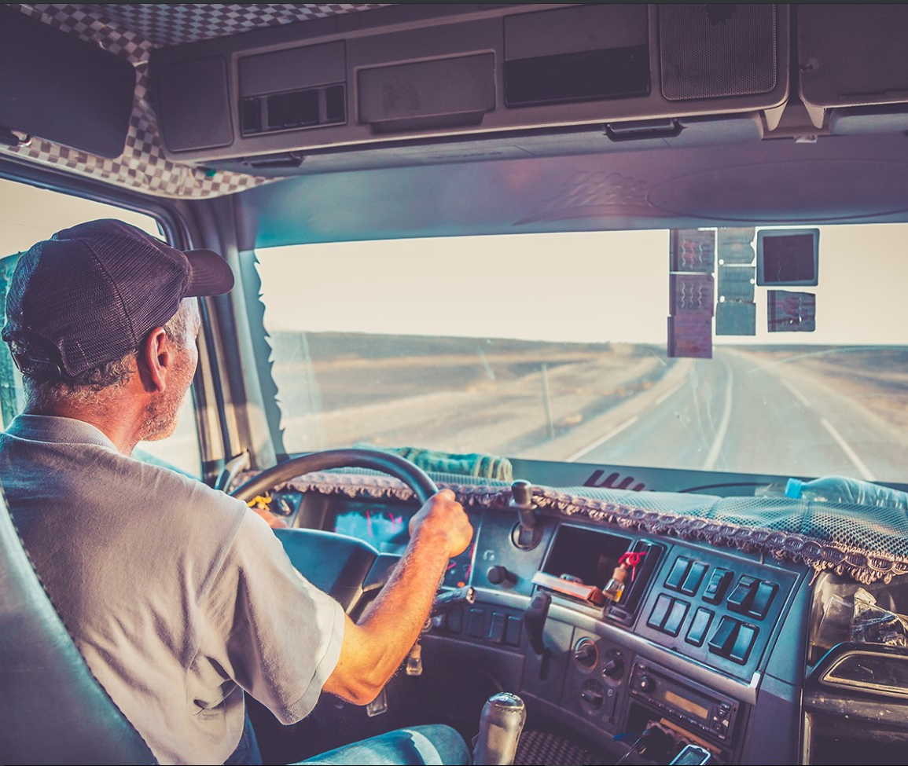
Imagine this ...
You are a commercial truck driver. This means ...
You drive for long hours without break.
You do not have a stable internet connection for navigation.
What would you do if you want to know where to go?
Some options:
Google/Apple/Bing maps?
Paper maps?
[1]

Slide 4




Map2Go meets all the needs!
The best solution for offline navigation!
Offline:
No internet connection is required
Customizable:
You choose your city
Searchable:
You choose your pit-stop
Simple:
Less distractions, more driving

Slide 5
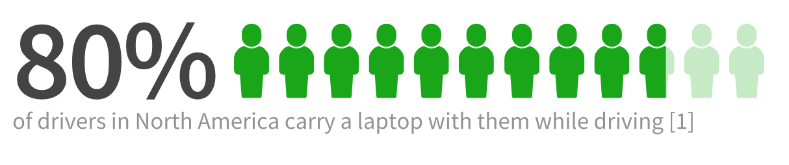

Slide 6
How we approach our work?
Core ideas which drive our actions
Notes:
‹#›
‹#›

Slide 7
How we approach our work?
Main guiding principles behind Map2Go
Highly responsive
Easy to learn
Application must acknowledge every user interaction quickly.
Interface must be intuitive and simple to use for every kind of user.
Achieves expected tasks
Pleasant to use
Features must be fully functional and must not break application in case of certain user actions.
Features of the application must provide a better user experience than competition.

Slide 8
How we approach our work?
Creating a “usable” design
Easy to learn
Usability aspect of our design [1]
Learnability: How easy is it for new users to understand the features of the application?
Satisfaction: How satisfied are users after using the application?
Interface must be intuitive and simple to use for every kind of user.
Pleasant to use
Features of the application must provide a better user experience than competition.

Slide 9
How we approach our work?
Creating a “responsive” design
Highly responsive
Responsiveness aspect of our design [1]
Must acknowledge user input within 0.0 - 0.2 sec.
Must present result of a simple task within 0.2 - 2.0 sec.
Must present the result of complex task within 5.0 - 15.0 sec.
Application must acknowledge every user interaction quickly.
Achieves expected tasks
Features must be fully functional and must not break application in case of certain user actions.

Slide 10
How Map2Go enhances usability?
A brief overview of features which add utility without adding complexity
Notes:
‹#›
‹#›

Slide 11
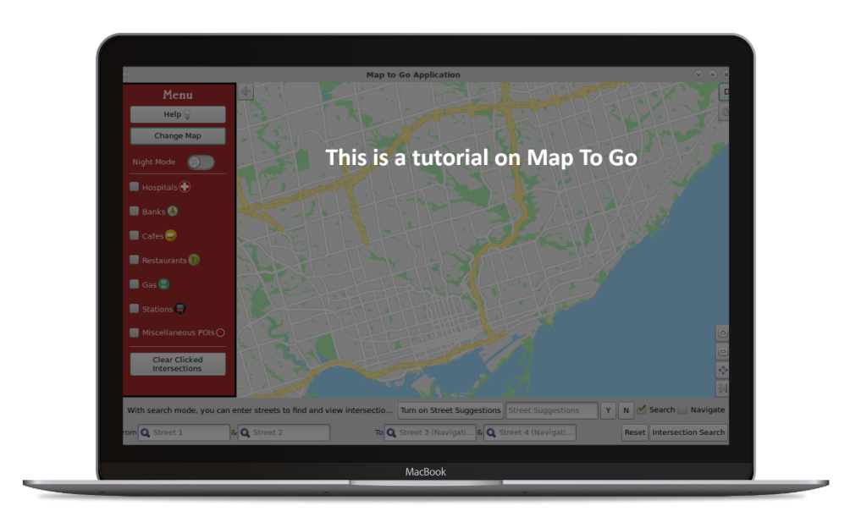
Tutorial increases learnability
Map2Go’s graphic tutorial for new users just by clicking “Help”
Full-screen graphics for easy viewing
Explain usage of every feature

Slide 12

Map2Go Tutorial Feature

Slide 13
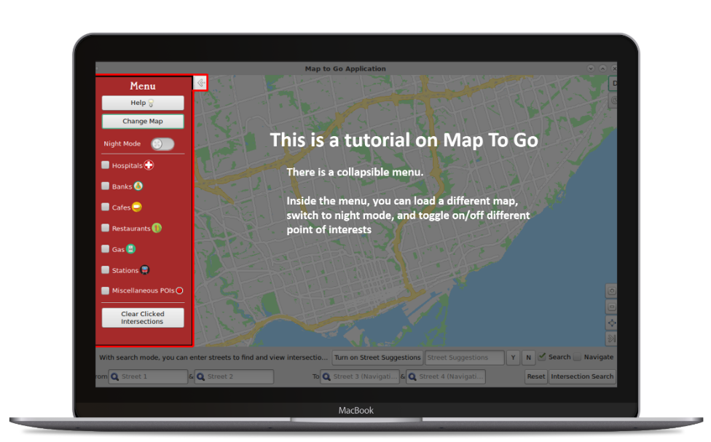
Intuitive widgets increase satisfaction
Collapsible menu with handy shortcuts like toggles and switches
Can be hidden to allow for full-view of map
Allows for an easy toggle for various features on the map
Allows for changing the city of the map

Slide 14
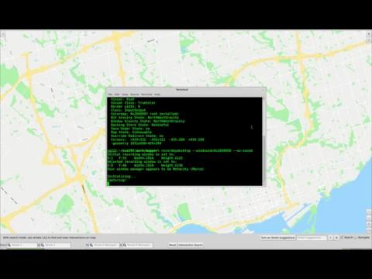
Map2Go Menu Feature

Slide 15
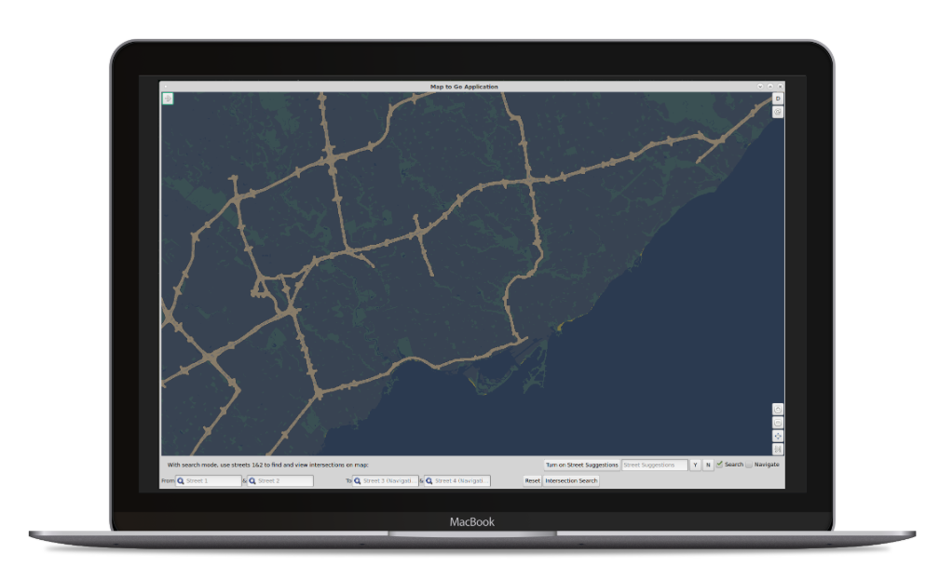
Night Mode improves user-experience
Night mode can reduce eye-strain during the dark
Reduces eye-strain when driving at night
Saves battery power
Enables with no lag or reloading of map

Slide 16
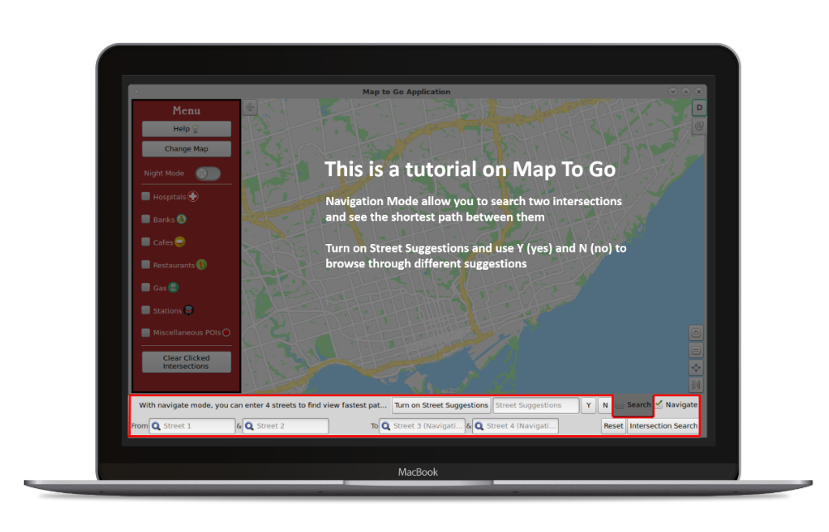
Find a path with ease
“Find” a place or “Navigate” to it with helpful instructions
Find allows for looking a particular intersection
Navigate shows path between two intersections
Street Suggestions provides real-time recommendations on street names entered

Slide 17
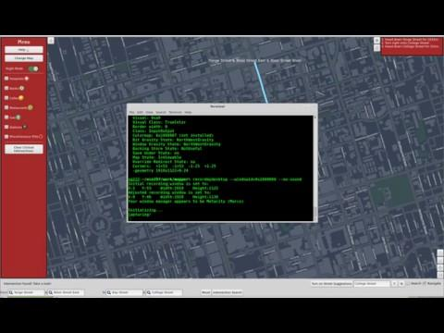
Map2Go Navigate and Find Feature

Slide 18
How responsive is Map2Go?
A collection of response times of complex algorithms used
Notes:
‹#›
‹#›

Slide 19

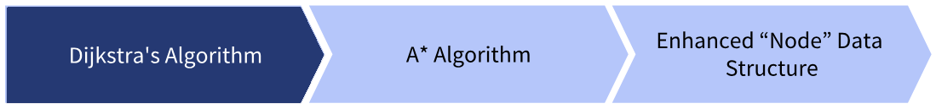
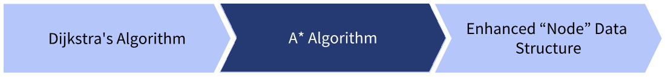
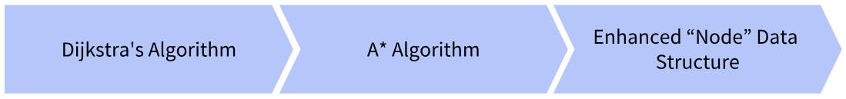
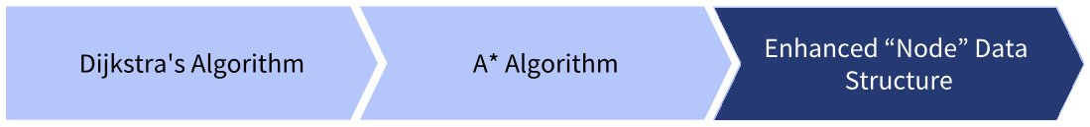
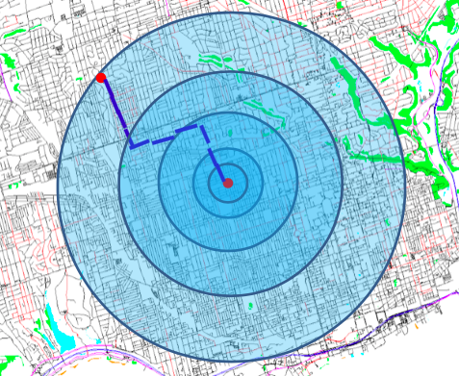
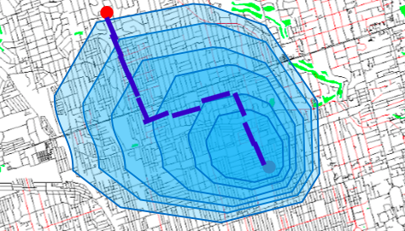
Improved Pathfinding in Map2Go
Efficient additions made to Pathfinding algorithm in M3
Creates data structure in load_map
Static instead of dynamic allocation
Reduced function calls in algorithm

Slide 20
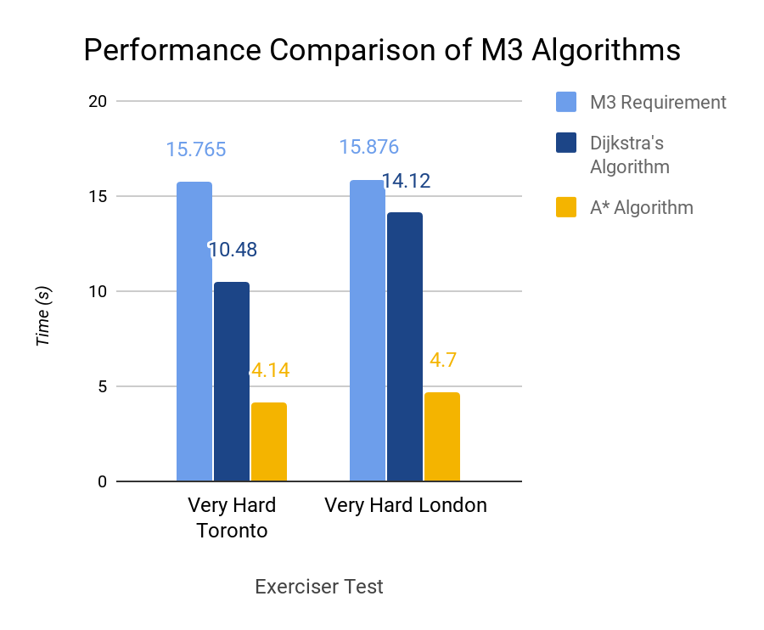
M3 Pathfinding Performance

Slide 21
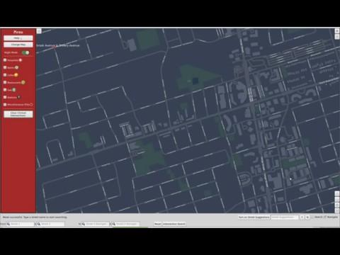
Pathfinding Demo

Slide 22
Travelling Courier Problem
Steps to the Final Solution
Notes:
‹#›
‹#›

Slide 23
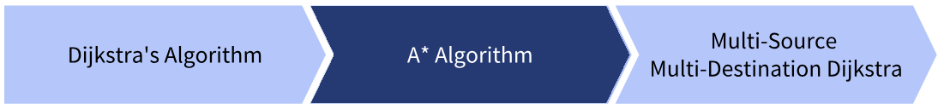
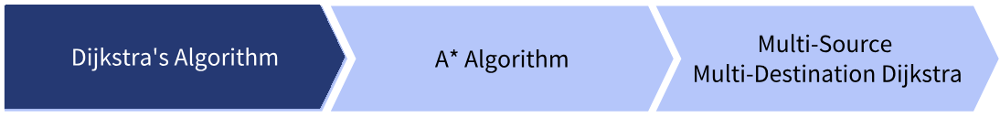
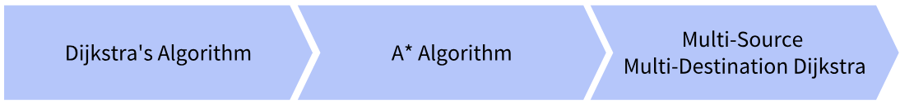
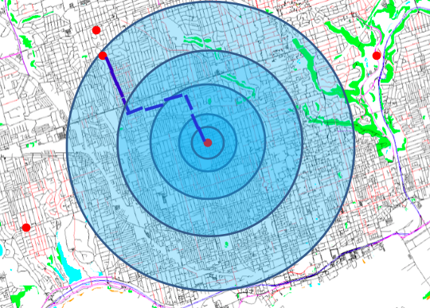
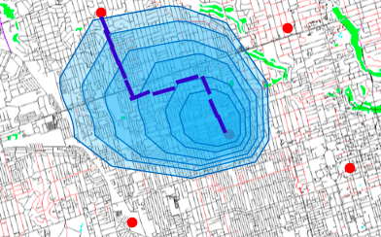
Enhancing Pathfinding Algorithm
Changes made on M3’s implementations for M4

Slide 24
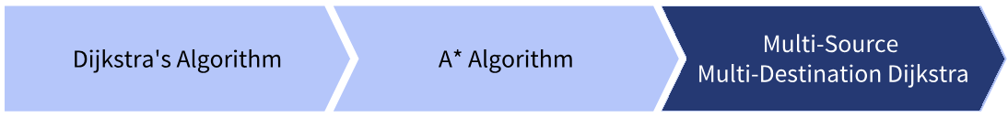
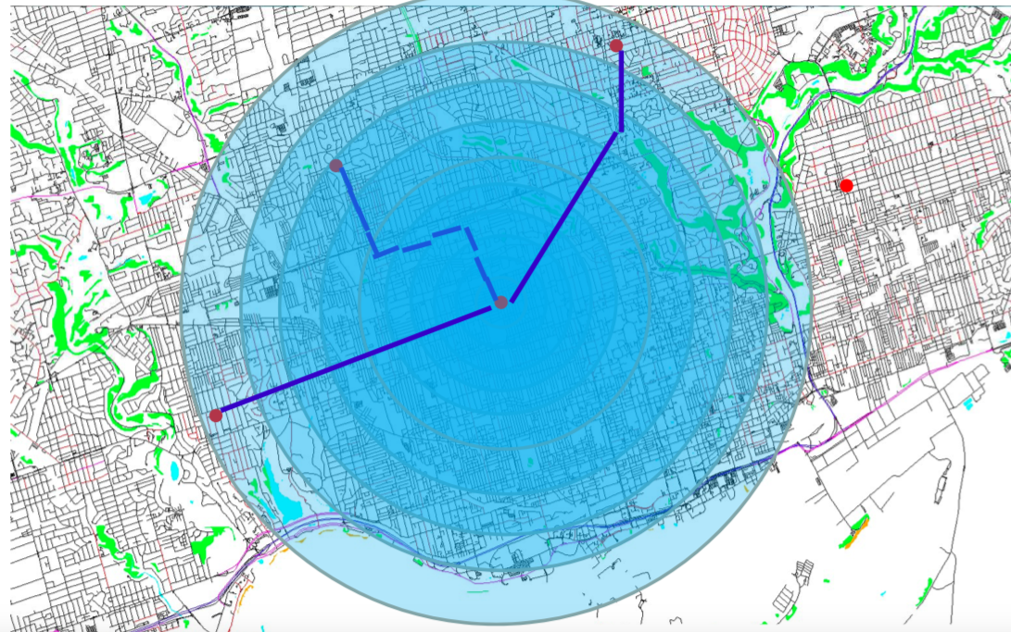
Enhancing Pathfinding Algorithm
Changes made on M3’s implementations for M4
New Data Structures
Unordered map for closest depots
Unordered map of unordered map for delivery locations

Slide 25
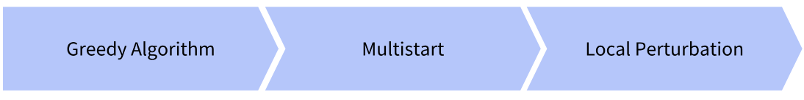
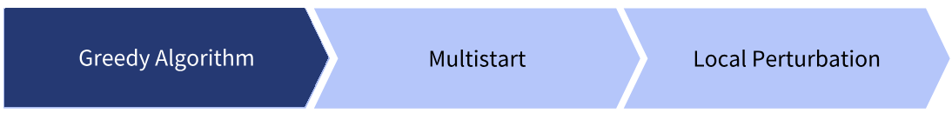
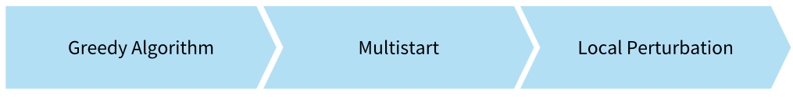
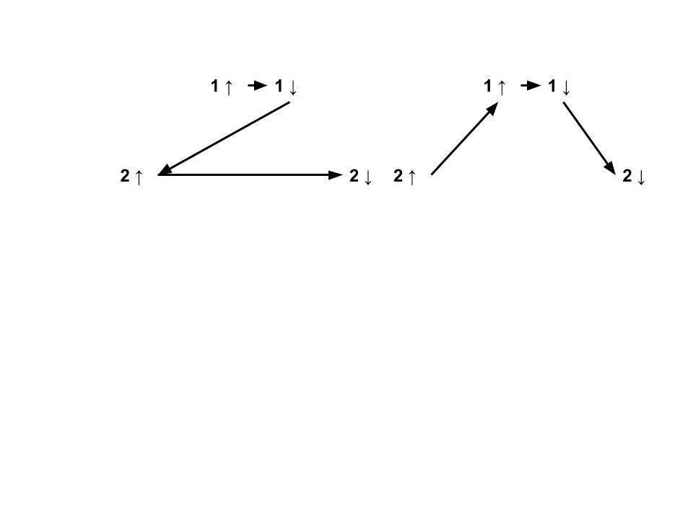
Basic Algorithms
Goes to closest legal location

Slide 26
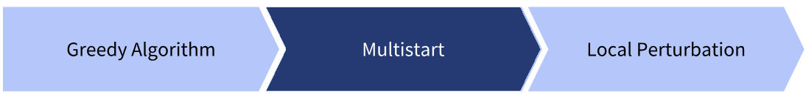
Basic Algorithms
Greedy search on every pickup location

Slide 27
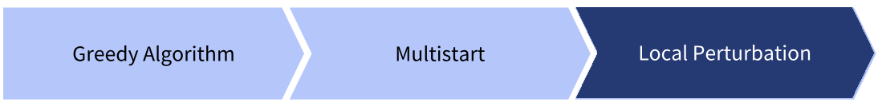
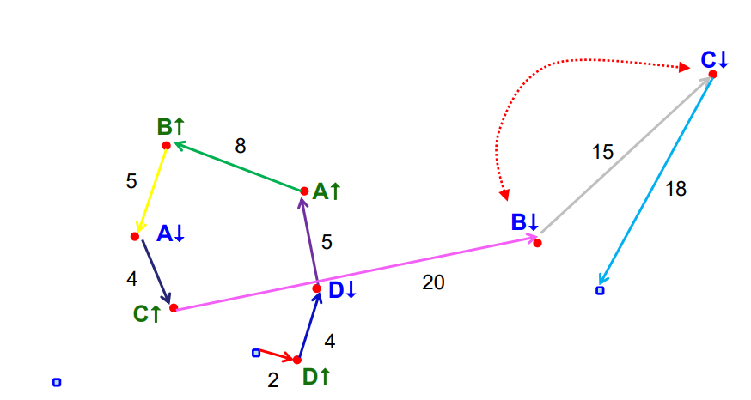
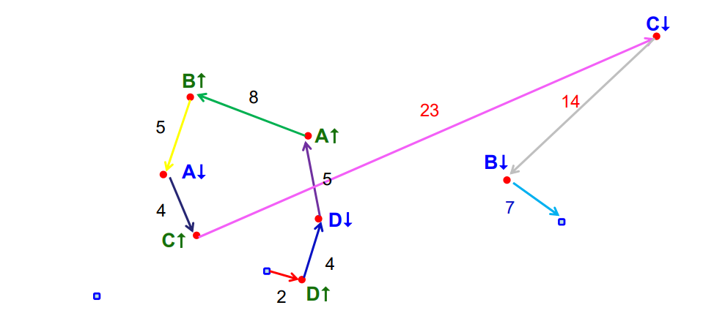
Basic Algorithms
Switches any two intersections

Slide 28
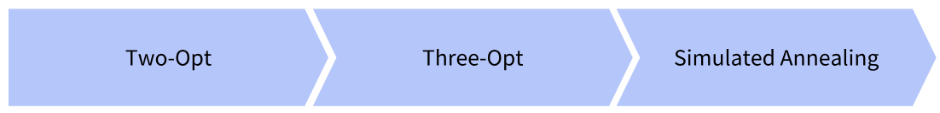
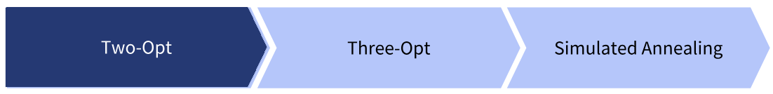
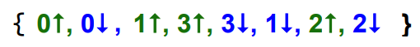
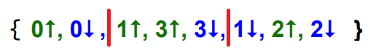
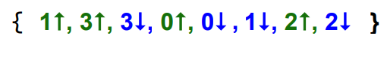
Advanced Algorithms
Split path into 3 sections
Rearrange

Slide 29
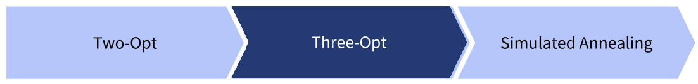
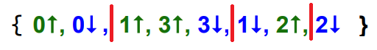
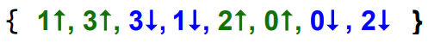
Advanced Algorithms
Split path into 4 sections
Rearrange

Slide 30

Advanced Algorithms
Uses Three-Opt Permutation
Initially allows worse changes

Slide 31
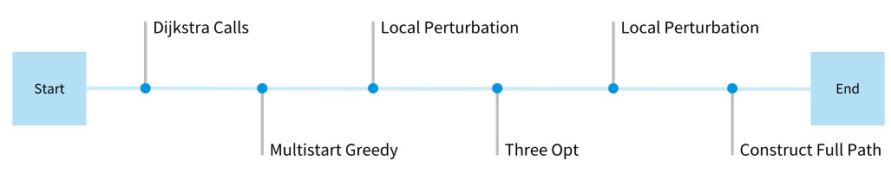
Final Algorithm

Slide 32
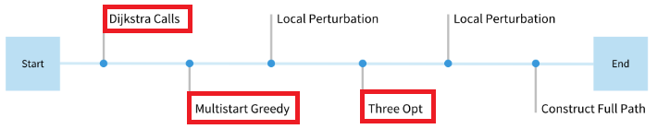
Multithreading Our Algorithms
Reduces execution time
Allows for more permutations

Slide 33
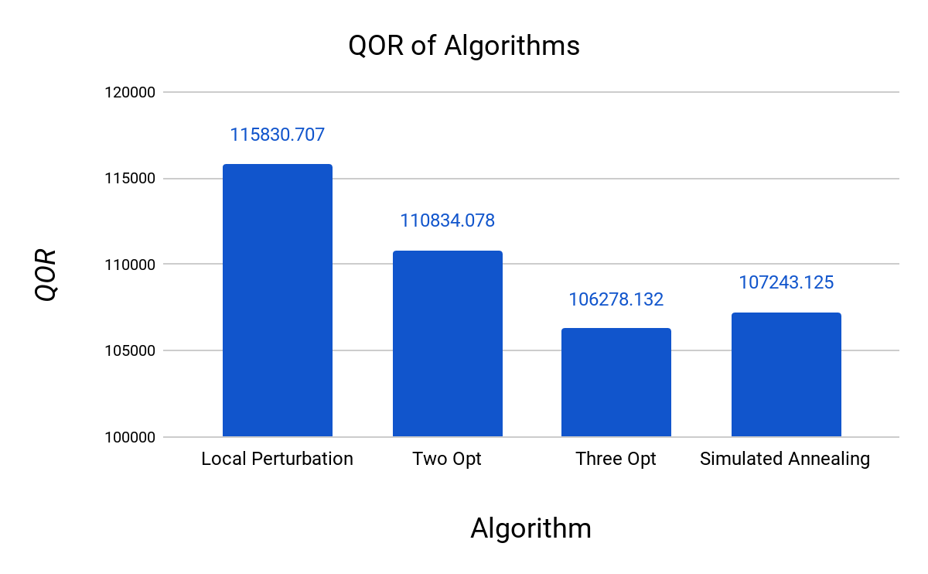
Algorithm Quality
Enter your subheadline here

Slide 34
The Pitch
The potential future development for Map2Go
Notes:
‹#›
‹#›

Slide 35
Wildfire Management
Future Plan for Map2Go
Notes:
‹#›
‹#›

Slide 36

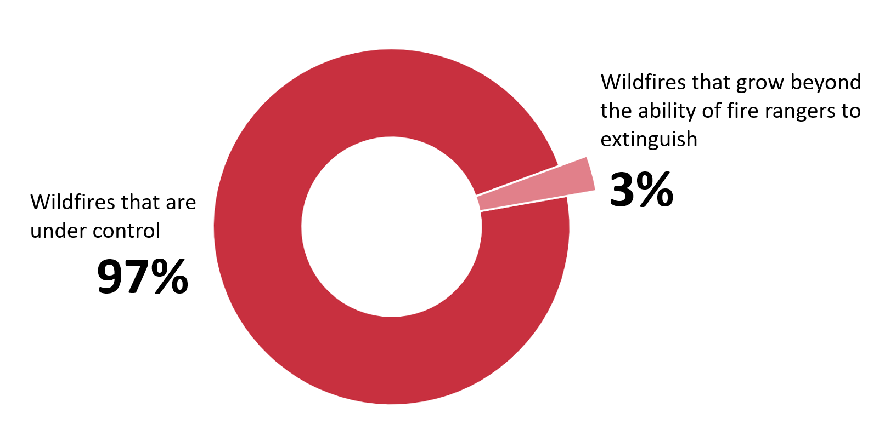
Wildfire is a huge issue in Canada
9,000 wildfires occur in Canada each year [1]
2% to 3% of these wildfires grow into uncontrollable forest fires [1]
[1] Canada, Natural Resources. “Canadian Wildland Fire Information System | Fire Monitoring, Mapping, and Modeling (Fire M3).” Accessed April 15, 2019. http://cwfis.cfs.nrcan.gc.ca/background/summary/fm3.
Notes:
http://cwfis.cfs.nrcan.gc.ca/background/summary/fm3

Slide 37
Effects of uncontrollable wildfires
account for more than 95% of the annual area burned, costing $500 million to $1 billion each year [1]
Top 3 country affected the most economically [2]
Estimate to double in 2040 [1]
[1] Canada, Natural Resources. “Cost of Fire Protection,” September 18, 2015. https://www.nrcan.gc.ca/forests/climate-change/forest-change/17783.
[2] “Table 3: The 20 Countries Most Affected, in Terms of Economic Damage,...” ResearchGate. Accessed April 15, 2019.
Notes:
https://www.nrcan.gc.ca/forests/climate-change/forest-change/17783

Slide 38
Effects of uncontrollable wildfires
pose a threat to indigenous communities
causing property damage and forcing relocation [1]
[1] Joseph, Bob. “Forest Fires and Indigenous Communities.” Accessed April 15, 2019. https://www.ictinc.ca/blog/forest-fires-and-indigenous-communities.
Notes:
https://www.nrcan.gc.ca/forests/climate-change/forest-change/17783

Slide 39
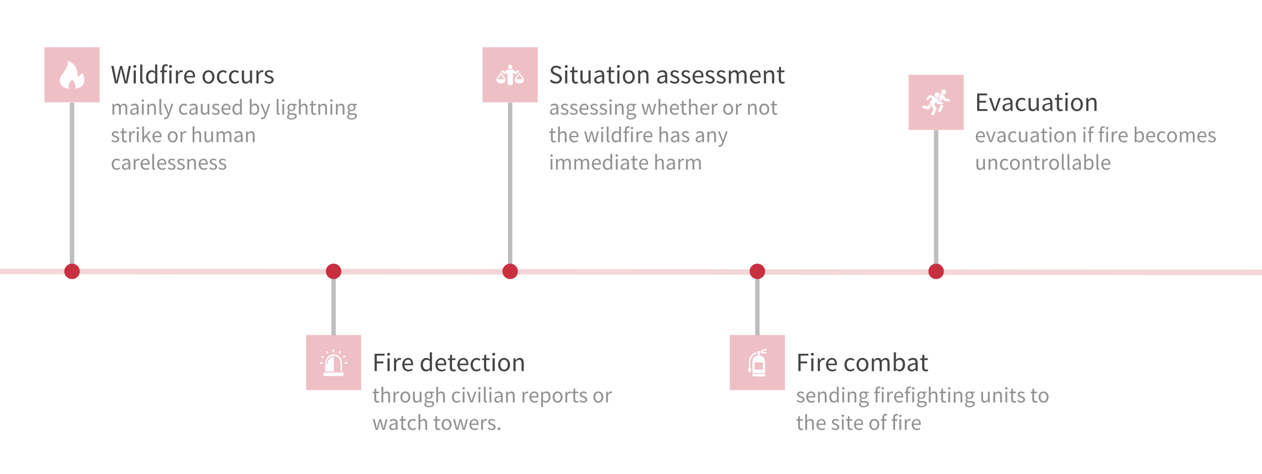
Current Fire Management Process
Phases of Fire Management [1]
[1] Canada, Natural Resources. “Forest Fire Danger Rating Tool,” January 20, 2014. https://www.nrcan.gc.ca/forests/fire-insects-disturbances/fire/14470.
Notes:
https://www.nrcan.gc.ca/forests/fire-insects-disturbances/fire/14470

Slide 40
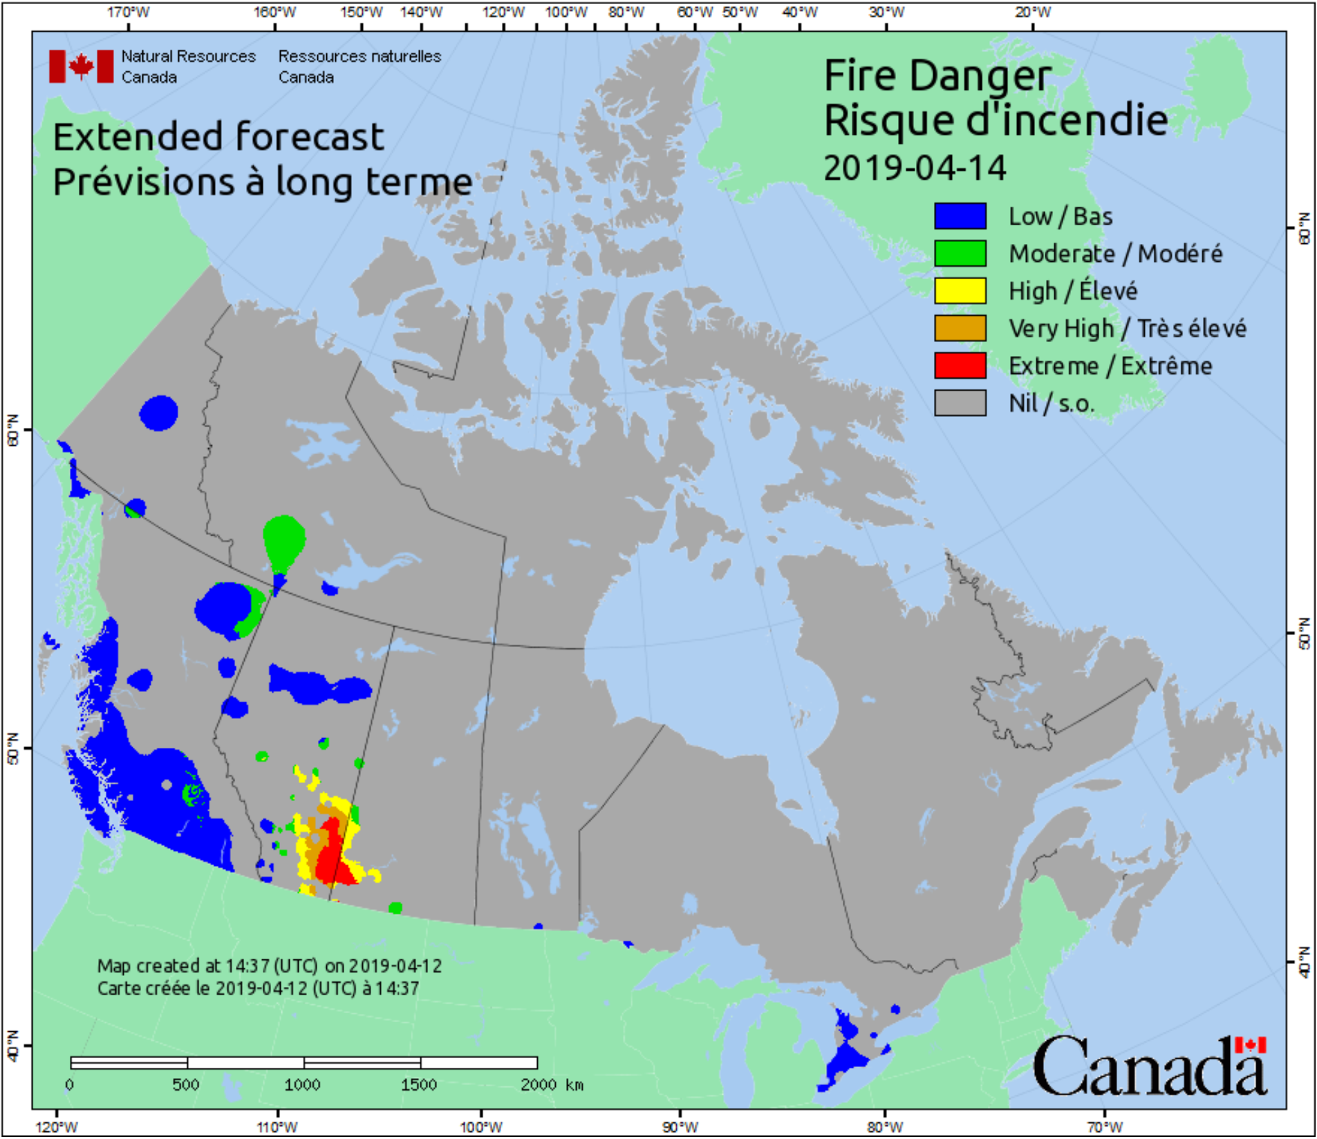
The most effective time to catch and stop an unwanted fire is right after it has started.
Surveillance drones, CWFIS
[1]
Phases of Fire Management
[1] Canada, Natural Resources. “Canadian Wildland Fire Information System.” Accessed April 15, 2019. http://cwfis.cfs.nrcan.gc.ca/home.

Slide 41
The most effective time to catch and stop an unwanted fire is right after it has started.
CWFIS, Surveillance drones
Phases of Fire Management
Notes:
https://www.nrcan.gc.ca/forests/fire-insects-disturbances/fire/14470

Slide 42

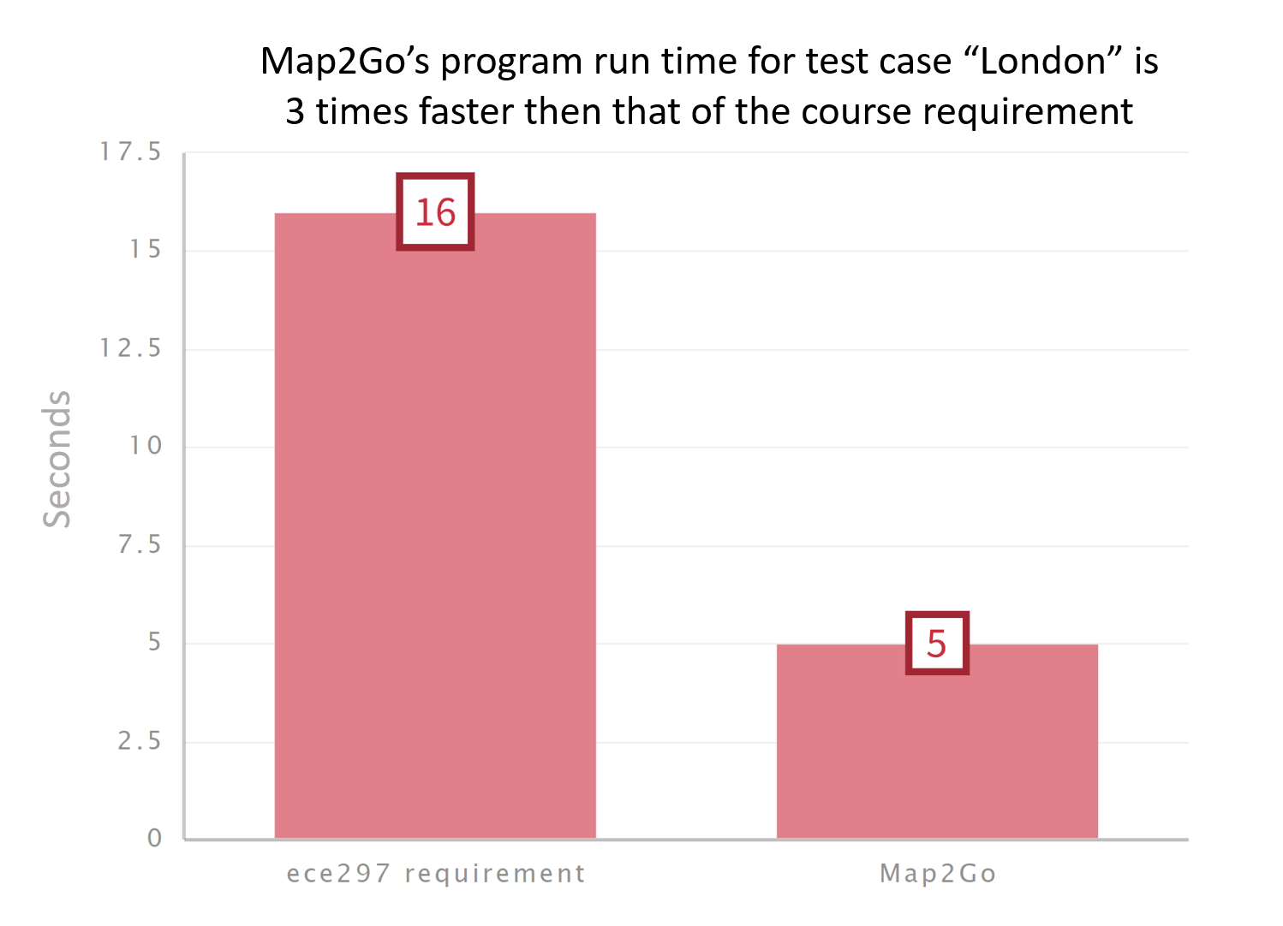
Our “Path Finding” feature can help with decision making
Our GIS emphasizes in the speed to form an optimal path between multiple locations.
Notes:
https://www.nrcan.gc.ca/forests/fire-insects-disturbances/fire/14470

Slide 43
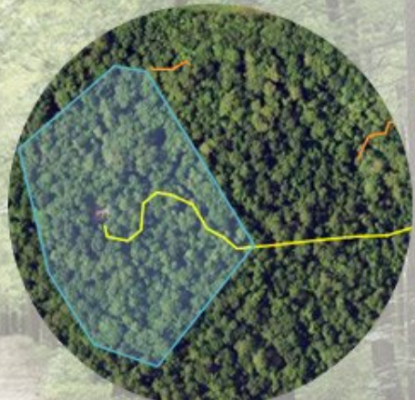
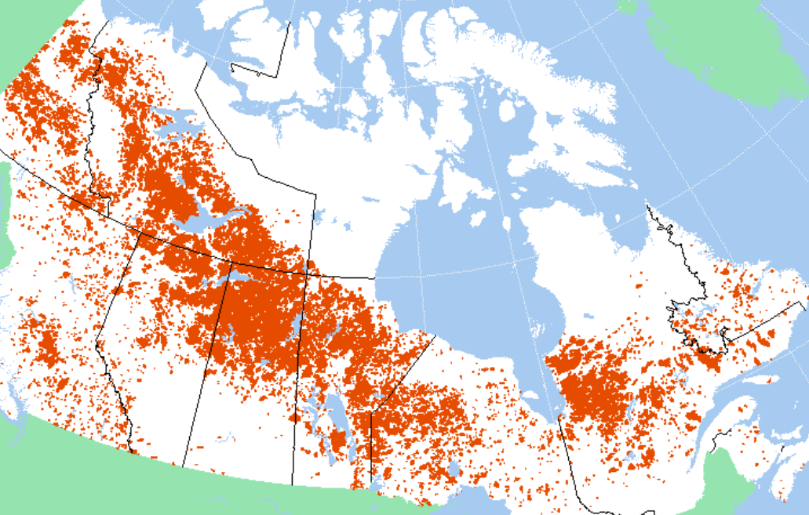
Functionalities to facilitate wildfire management
Show fire-activity
Map out forest paths
Notes:
https://www.nrcan.gc.ca/forests/fire-insects-disturbances/fire/14470

Slide 44
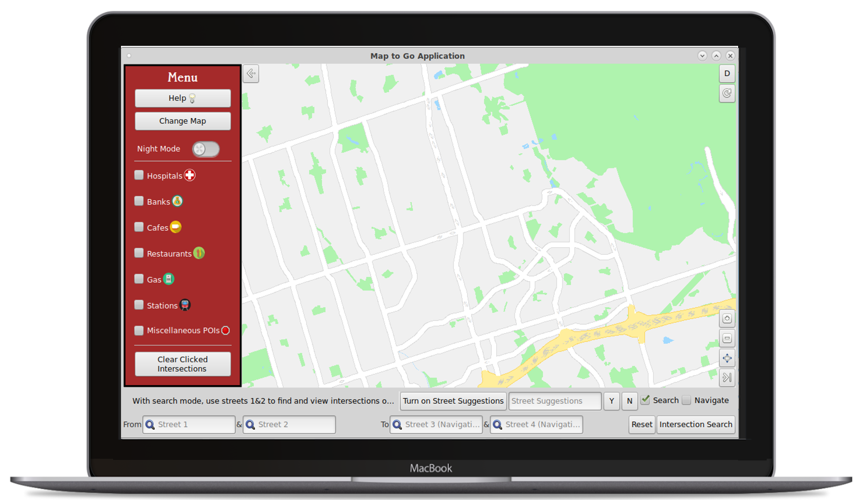
Our Vision:
Notes:
https://www.nrcan.gc.ca/forests/fire-insects-disturbances/fire/14470

Slide 45
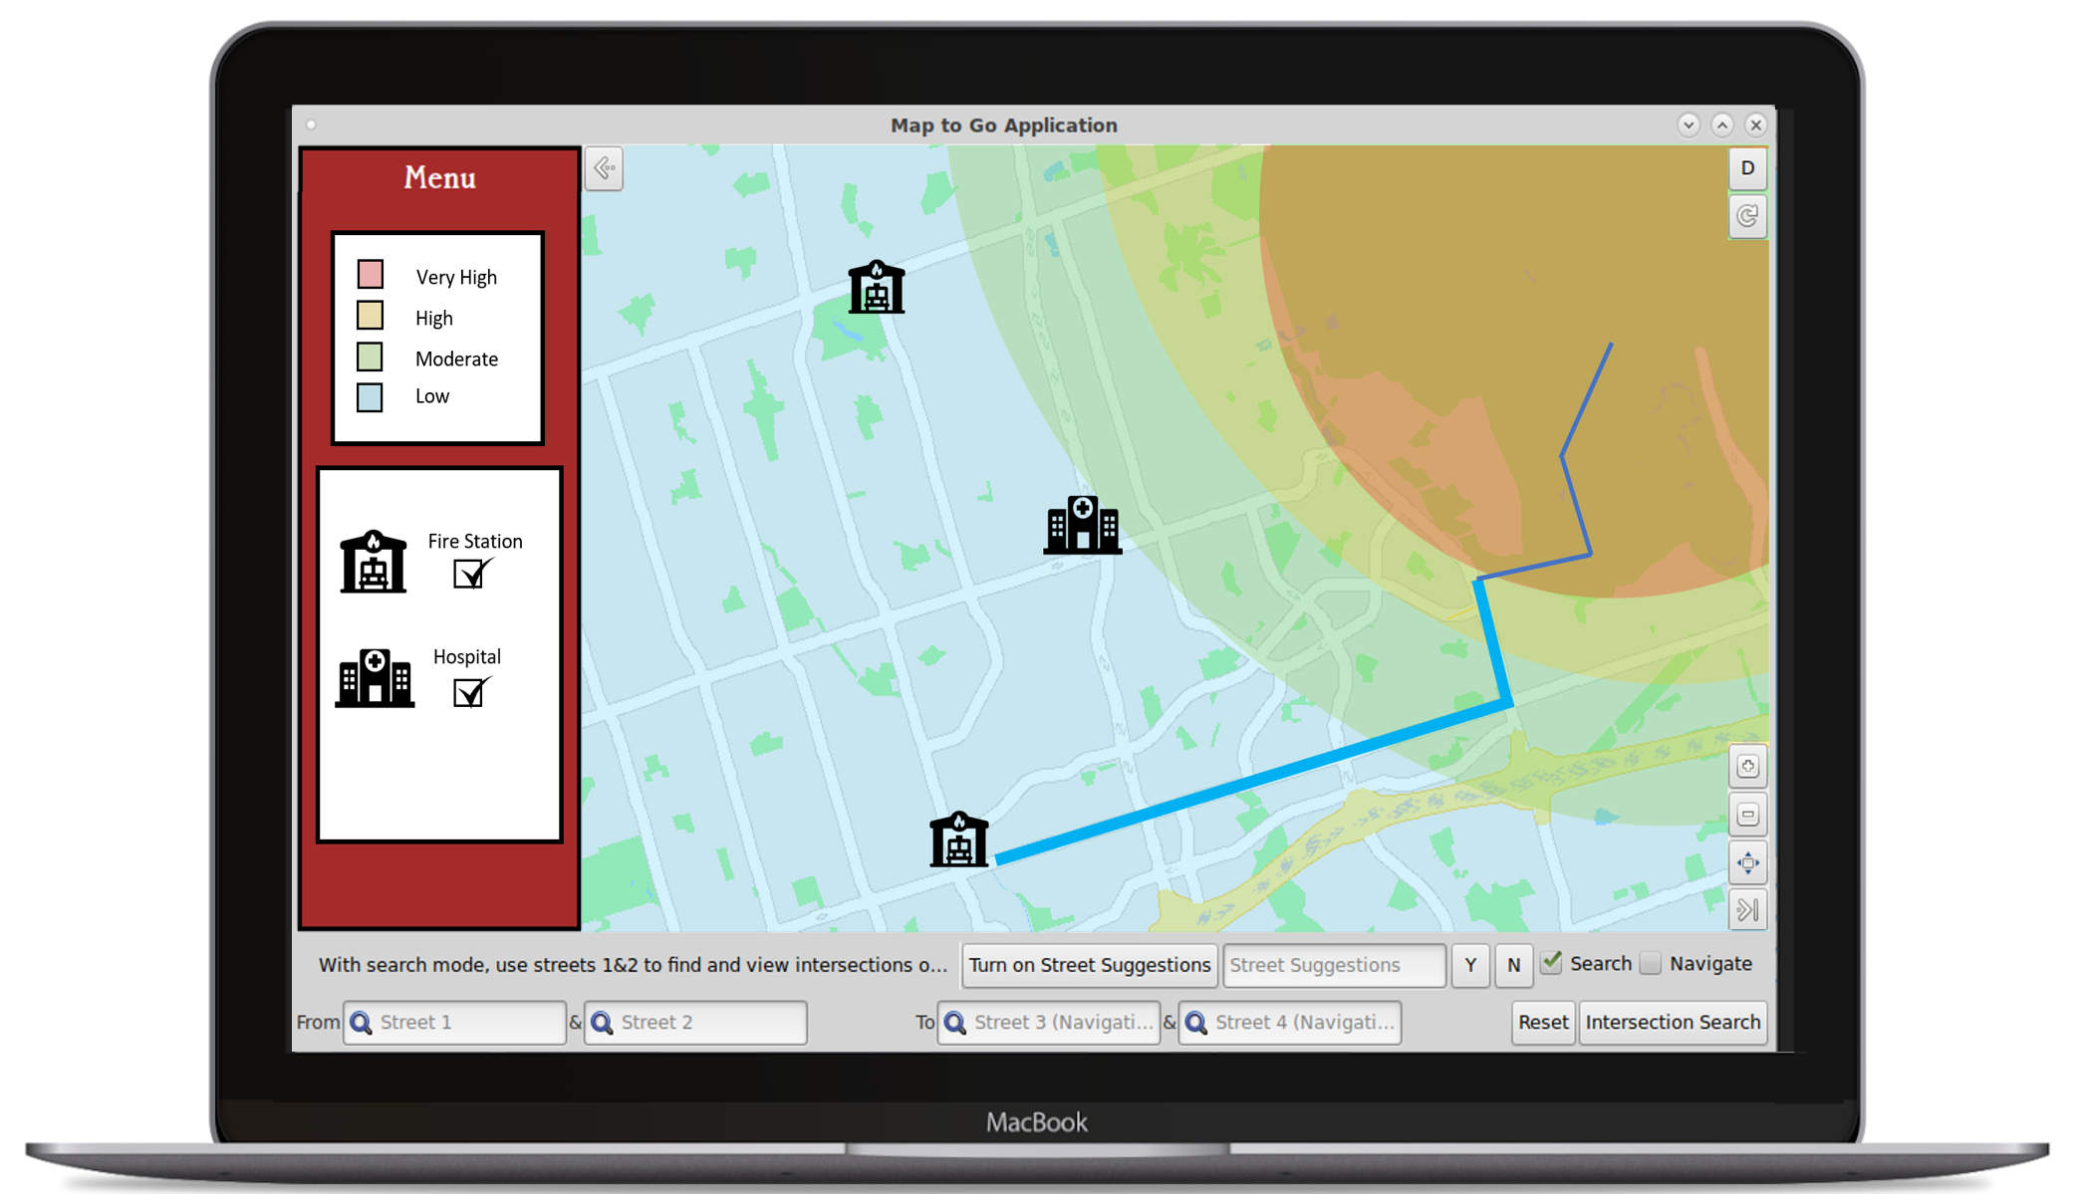
Our Vision:
Danger Level
Notes:
https://www.nrcan.gc.ca/forests/fire-insects-disturbances/fire/14470

Slide 46

Who will benefit?
Monitor fire activities
Make appropriate firefighting decision
Reduce chances of evacuation
Reduce property damage
Notes:
https://www.nrcan.gc.ca/forests/fire-insects-disturbances/fire/14470

Slide 47
Summary of Map2Go
Usability
Graphic Tutorials improve learnability
Menu and widgets increase user satisfaction
Responsiveness
Dijkstra → A* to find optimal path
adding multithreading, perturbation, and three opts to find a quality courier path
Pitch
Expanding Map2Go to facilitate fire management process
Notes:
‹#›
‹#›

